Slide 1
PerfTest: Setup (TPTP)
Yoonki Song
Last Updated: Sep. 6, 2009

Slide 2
Agent Controller
Installation and Configuration on the Server side

Slide 3
Two Types of Agent Controller
IBM Rational Agent Controller (a.k.a Integrated Agent Controller)
ACWinService.exe
Standalone Agent Controller
ACService.exe

Slide 4
Repository
http://www.eclipse.org/tptp/home/downloads/?ver=4.5.1
Download “Agent Controller” runtime

Slide 5
Configure Environment Variables
JAVA_HOME=C:\Program Files\Java\jdk1.5.0_21
TPTP_AC_HOME = C:\tptpAC
JAVA_PROPILER_HOME=%TPTP_AC_HOME%\plugins\org.eclipse.tptp.javaprofiler
PATH=%JAVA_PROFILER_HOME%;%PATH%;%TPTP_AC_HOME%\bin
PATH=%PATH%;%JAVA_HOME%\bin
PATH = %TPTP_AC_HOME%\bin

Slide 6
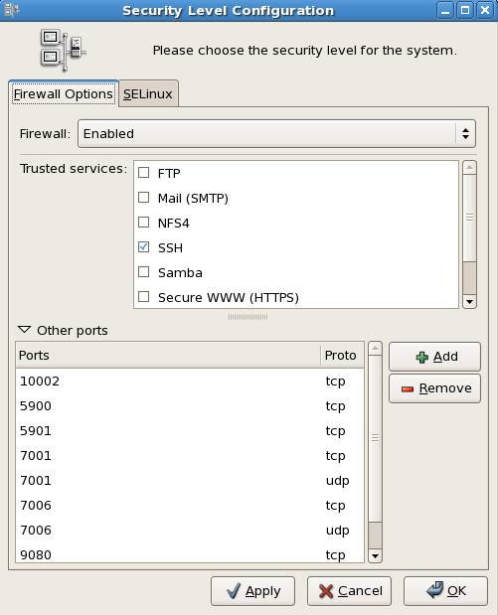
Ports should be opened
10002
10003
10004
10005
10006
system-config-securitylevel

Slide 7
Configuration
Configuring
<install-dir>\bin\SetConfig.bat
Starting Agent Controller (Admin)
manageservice add “Agent Controller” “C:\tptpAC”
Querying Agent Controller Version Information
<install-dir>\bin\acserver –v
Checking Agent Controller Installation
<install-dir>\bin\SampleClient

Slide 8
TPTP v4.5.1
Installation and Configuration on the CLIENT side

Slide 9
Repository
http://www.eclipse.org/tptp/home/downloads/?ver=4.5.1
Download “TPTP all-in-one package”

Slide 10
Create profile

Slide 11
Trouble Shooting

Slide 12
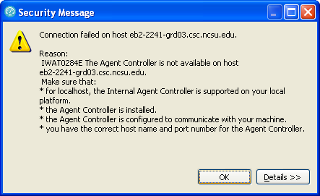
IWAT0284E
IWAT0284E
http://www-01.ibm.com/support/docview.wss?uid=swg21281597

Slide 13
the launch requires at least one data collector to be selected.

